Slide 1
Integration of Workflow

Slide 2
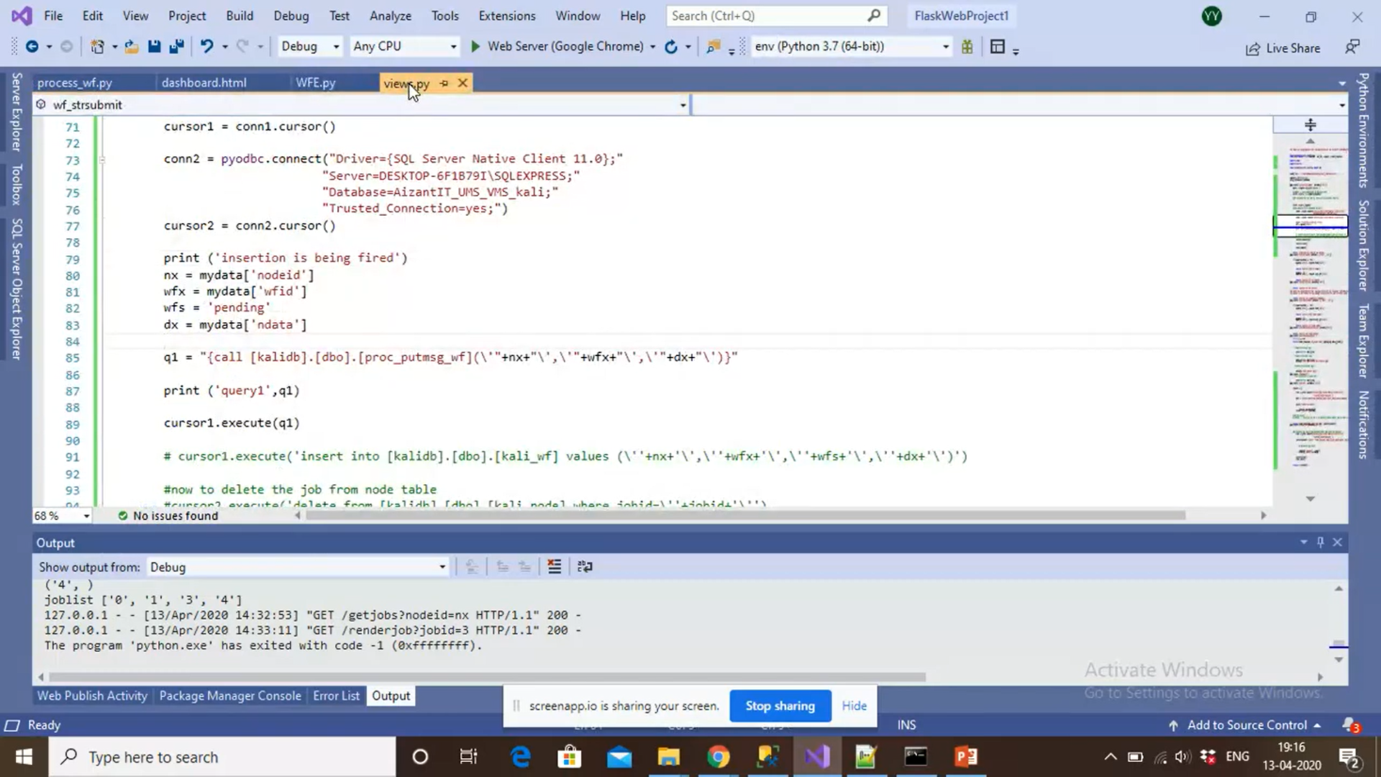
2 files, views.py, and wfe.py

Slide 3


Slide 4
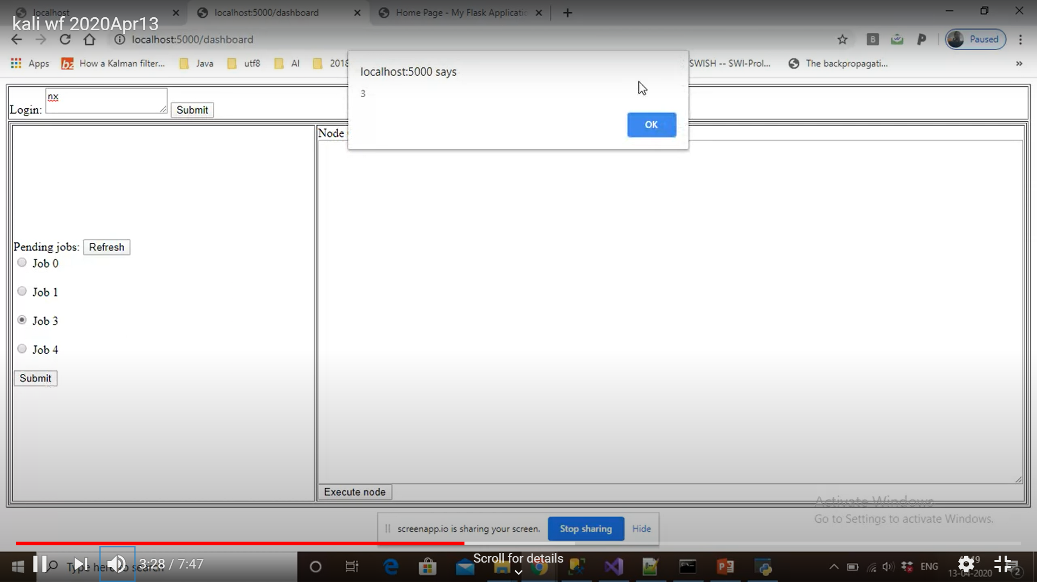
fetchPendingJobs()
- Radio button id:node_0/node_1…
Value:0/1…
- renderjob() accesses jobs by their value (0/1/2)
Processing Job 3
renderJob()
submitNode()

Slide 5
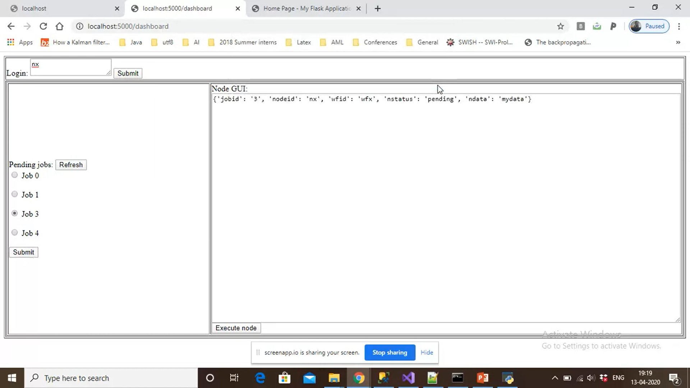
RenderJobs()
Performs this
Node GUI can be replaced with a proper GUI
GUI itself is a variable, can be a key-value pair, coming from workflow system.
GUI can be given a appropriate (rendering-template)
PendingJobs()
is used to get pending jobs

Slide 6
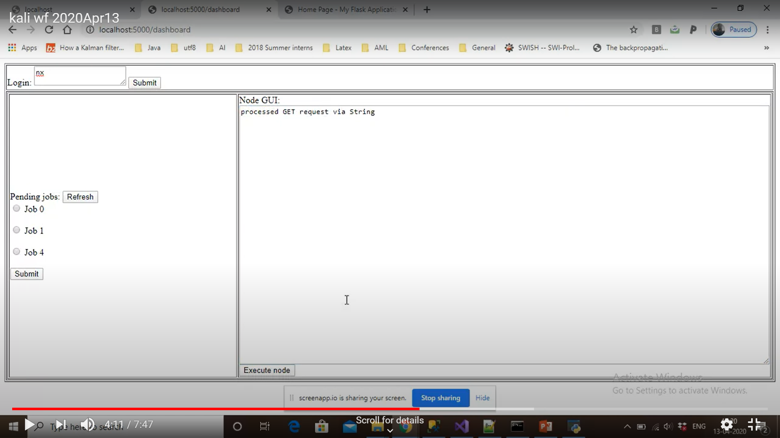

Slide 7
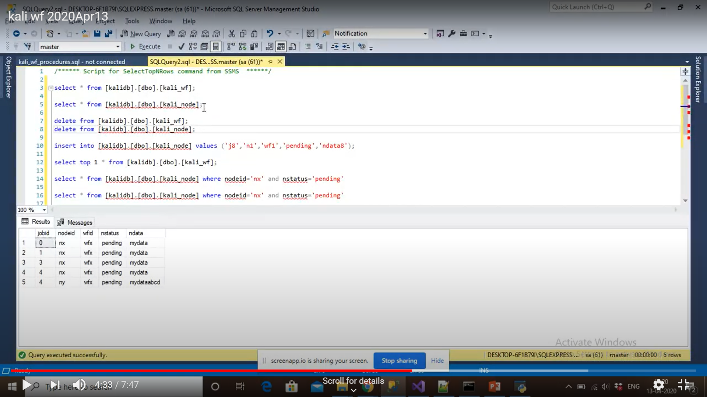
Initially 4 pending jobs in nodes were there.

Slide 8
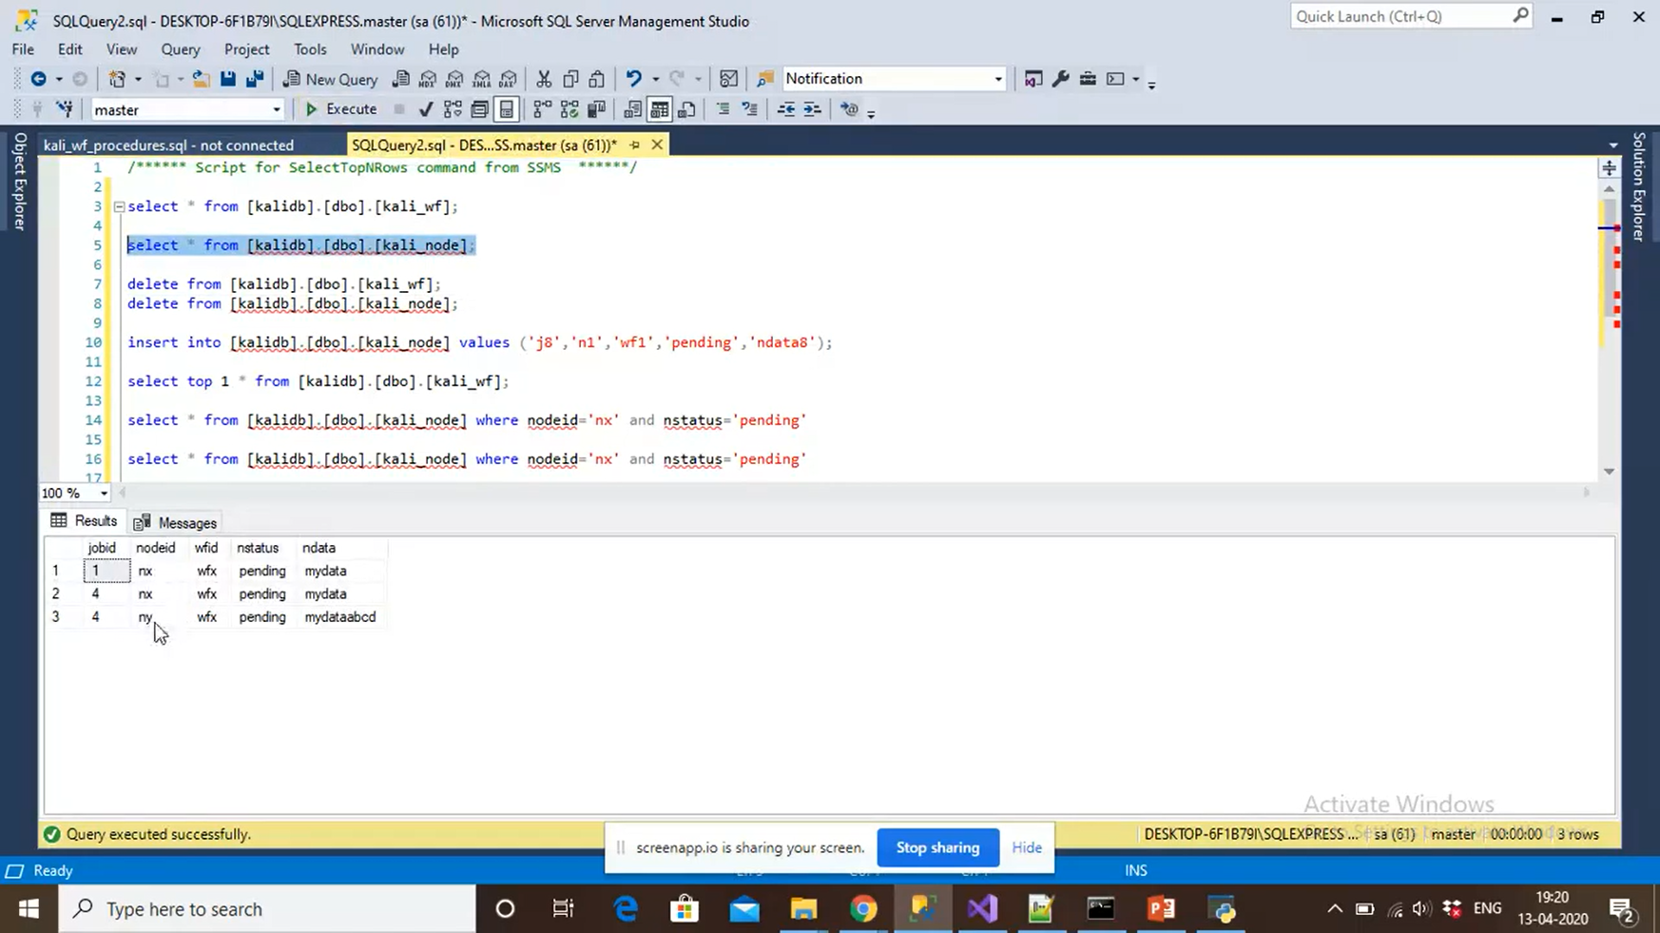
Now we have only 2 pending jobs in nodes

Slide 9
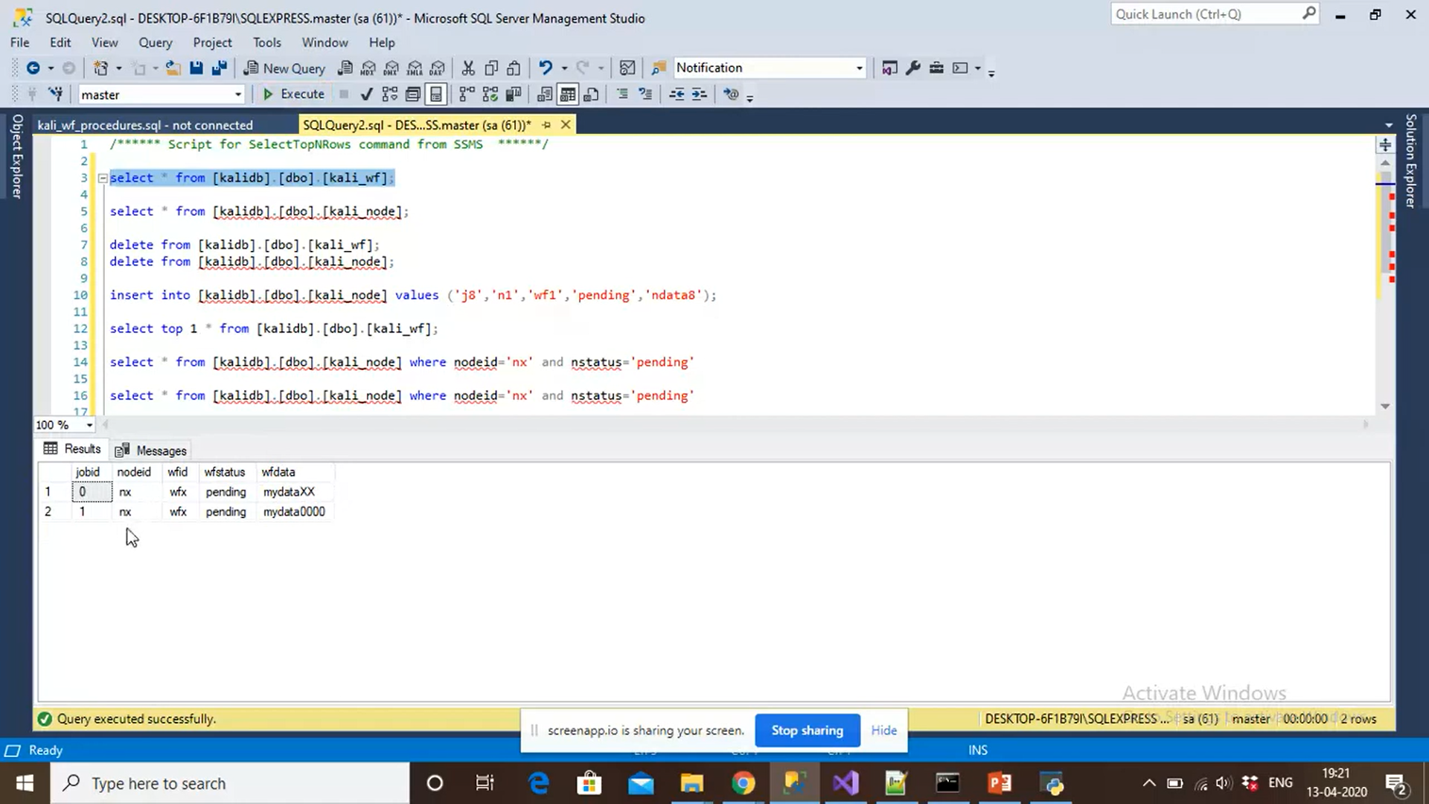
These jobs processed by nodes are now pending in workflow table

Slide 10
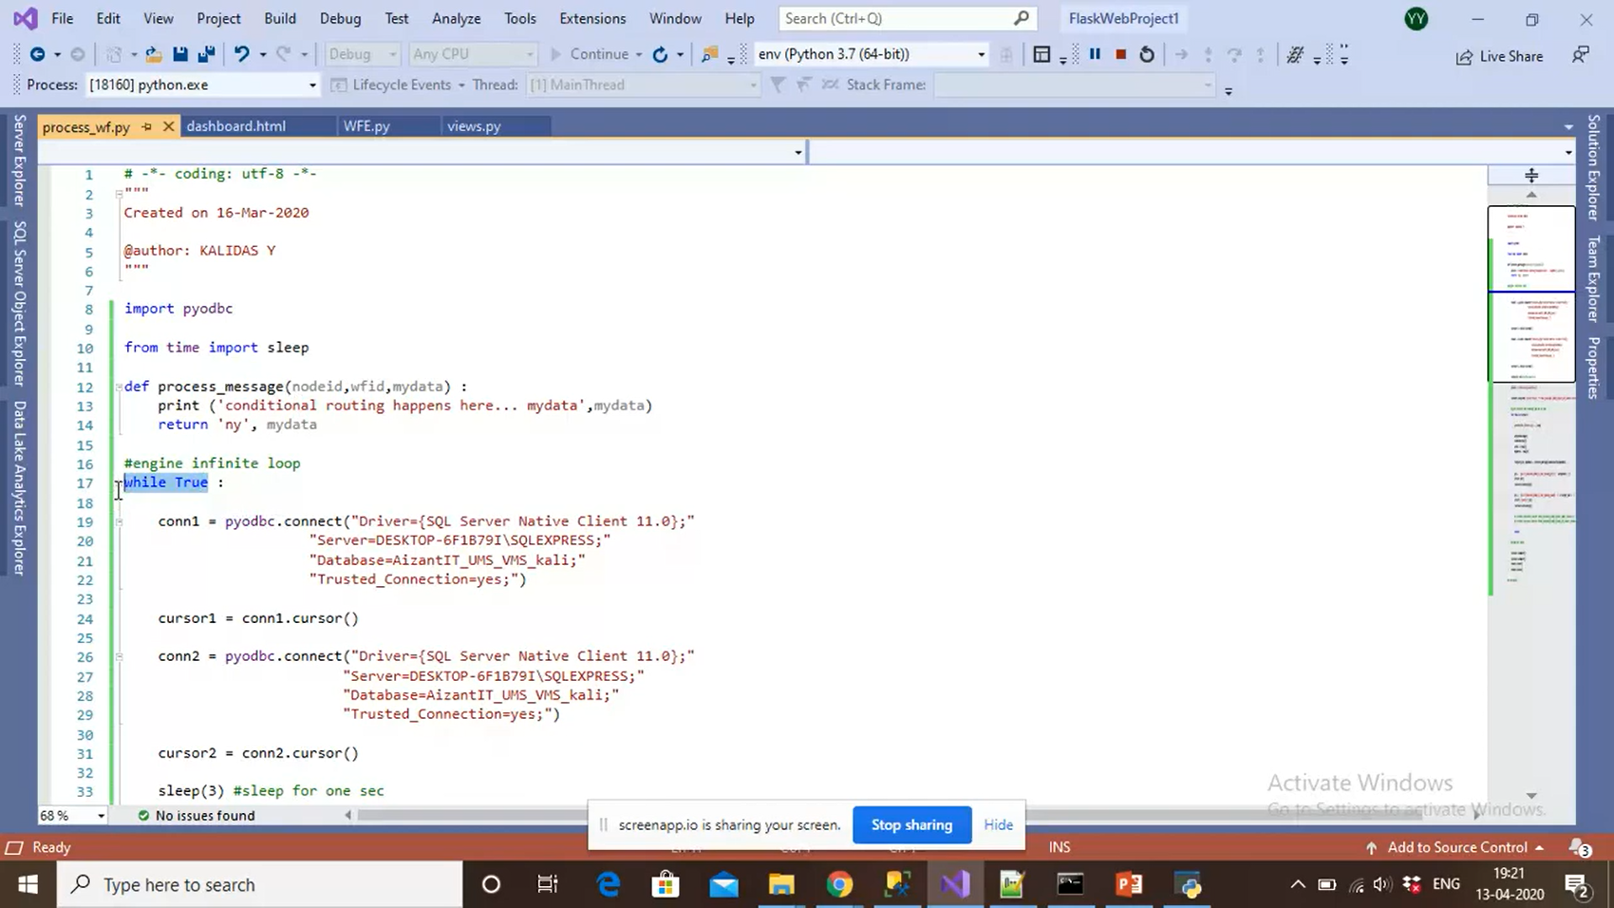
We need to execute the workflow in this infinite loop.

Slide 11
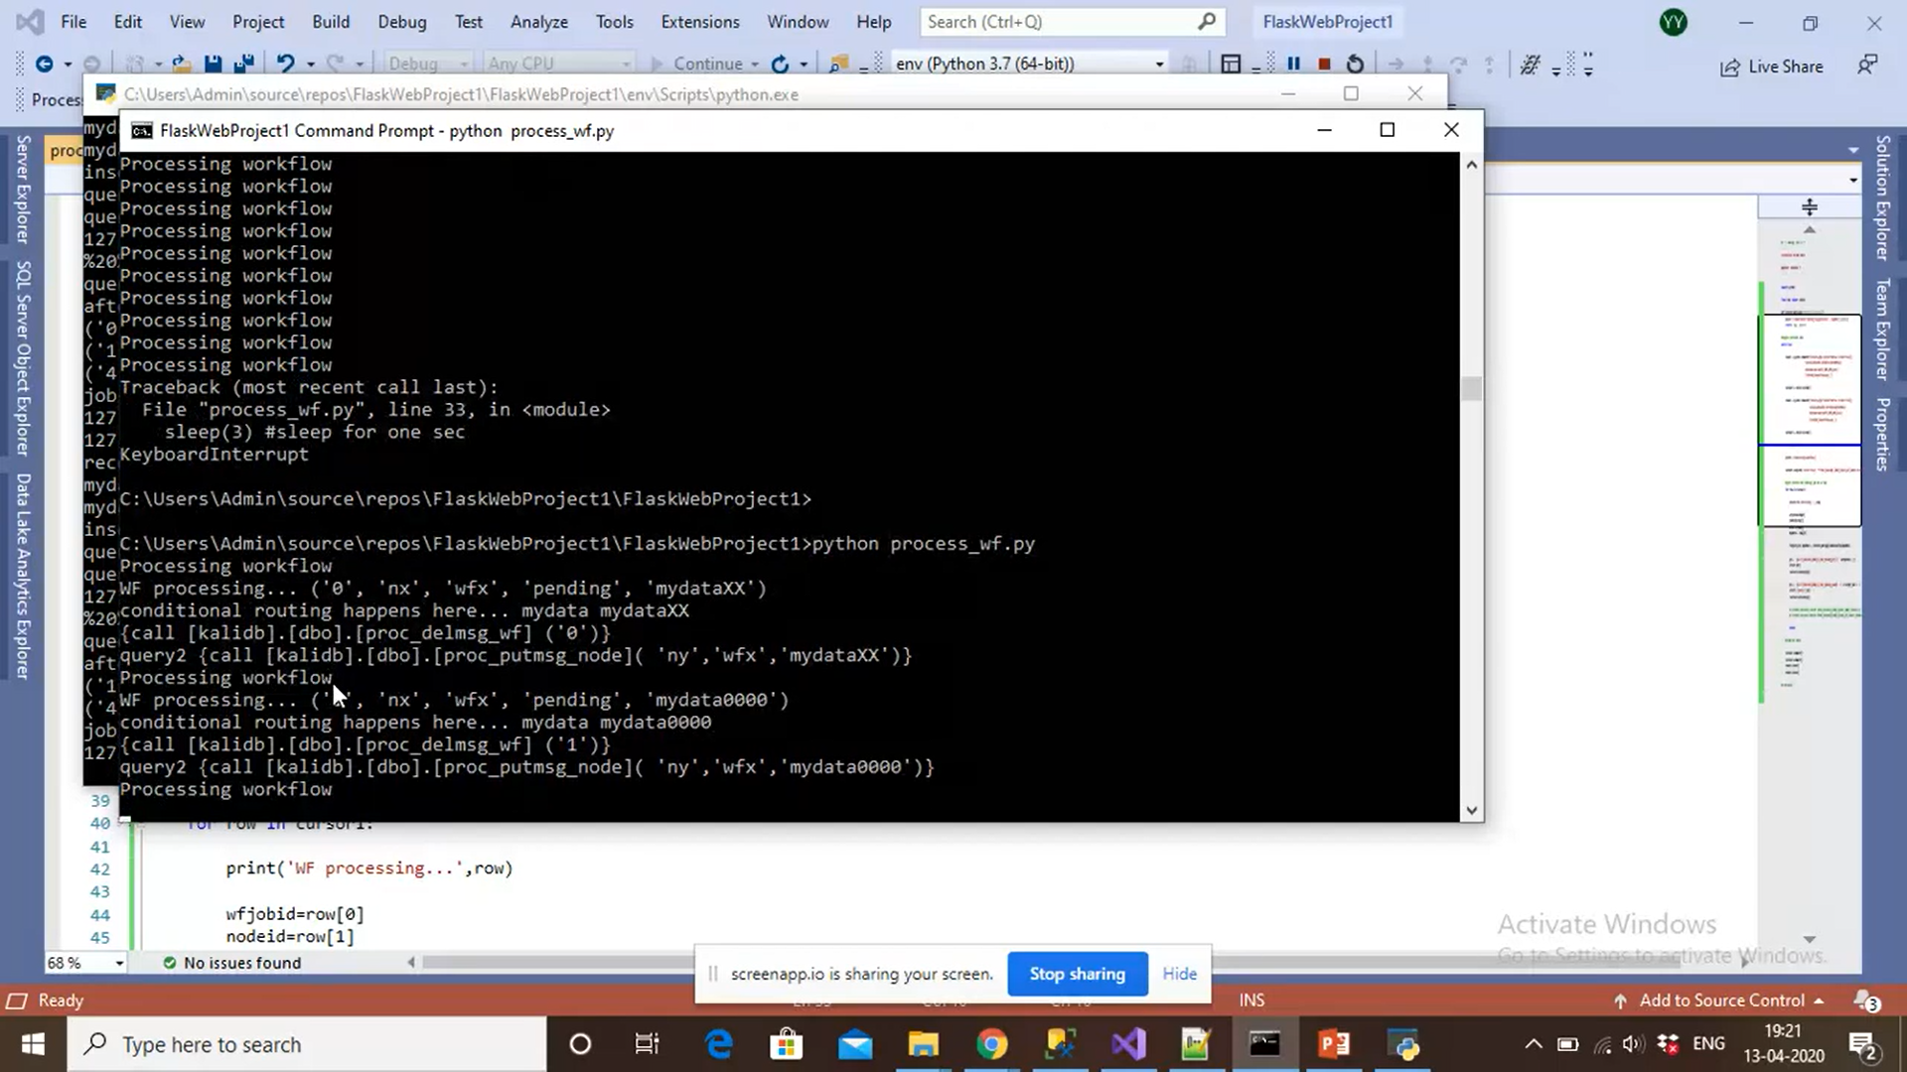
The workflow has processed 2 workflow processes

Slide 12
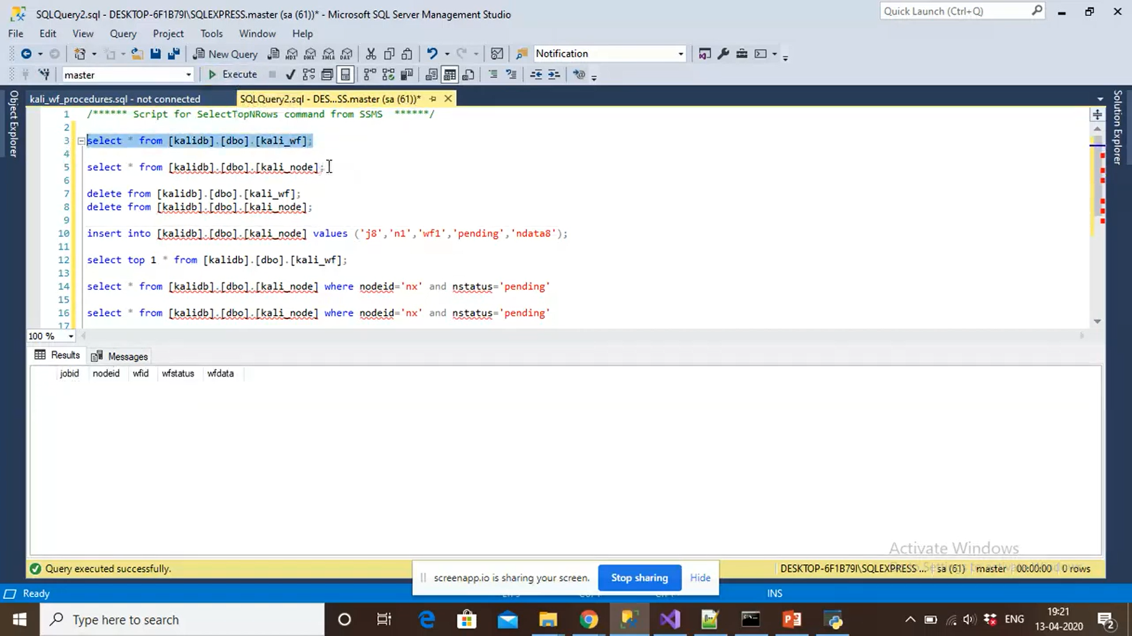
The pending workflow processes are gone(as it has been processed by workflow)

Slide 13
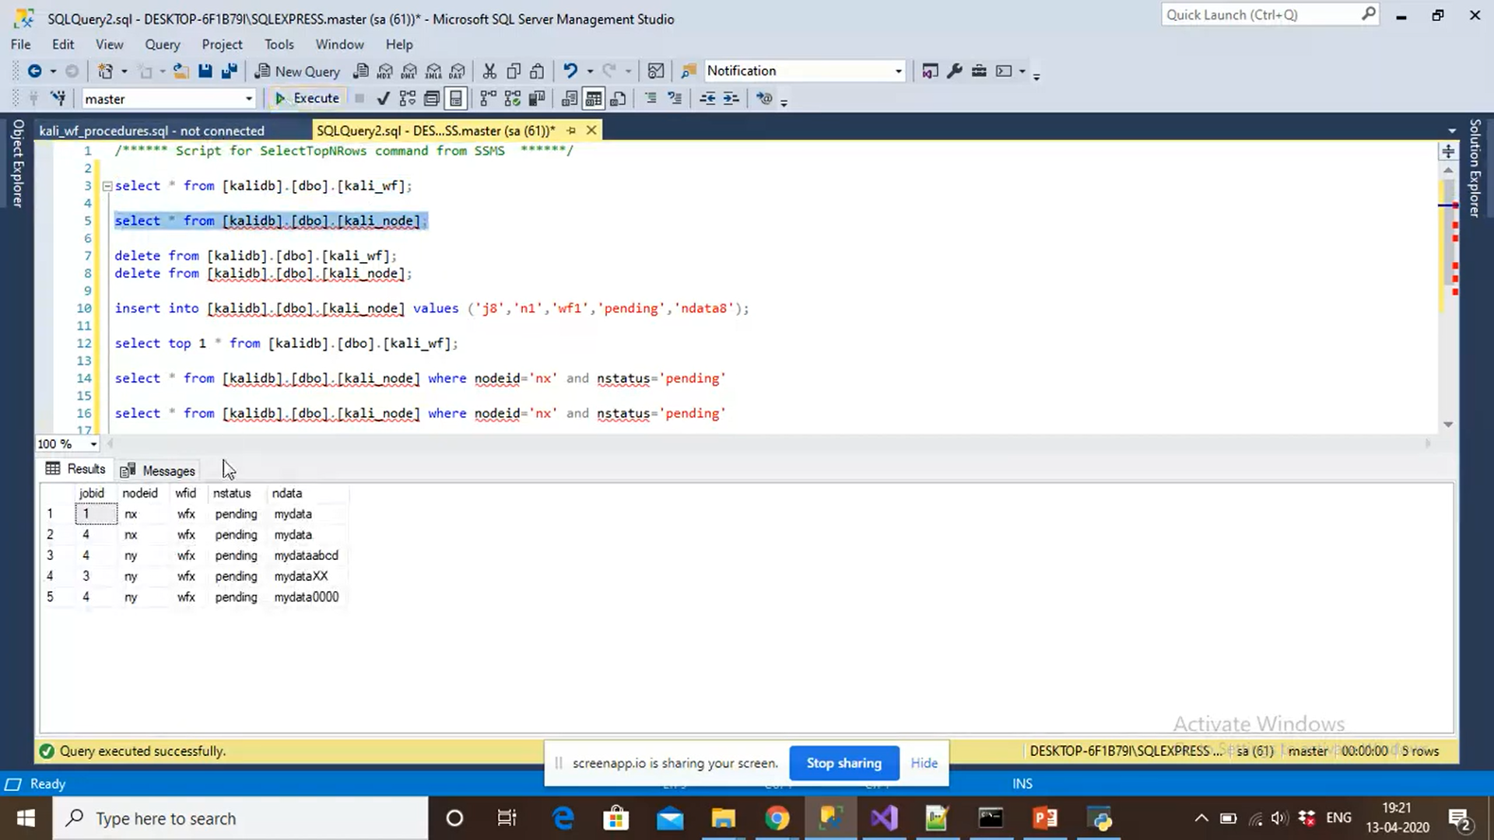
nx -> ny
Since workflow has done processing, the pending workflow jobs is removed from workflow-table.
They are back on node-table with nodeid as ‘ny’

Slide 14
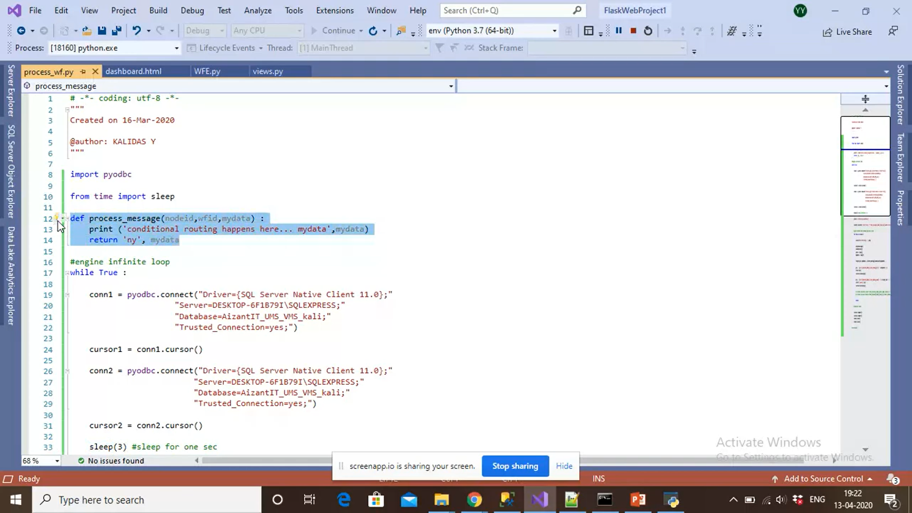
This redirection is happening here.
Conditions should be load dynamically here, independent of the workflow.

Slide 15
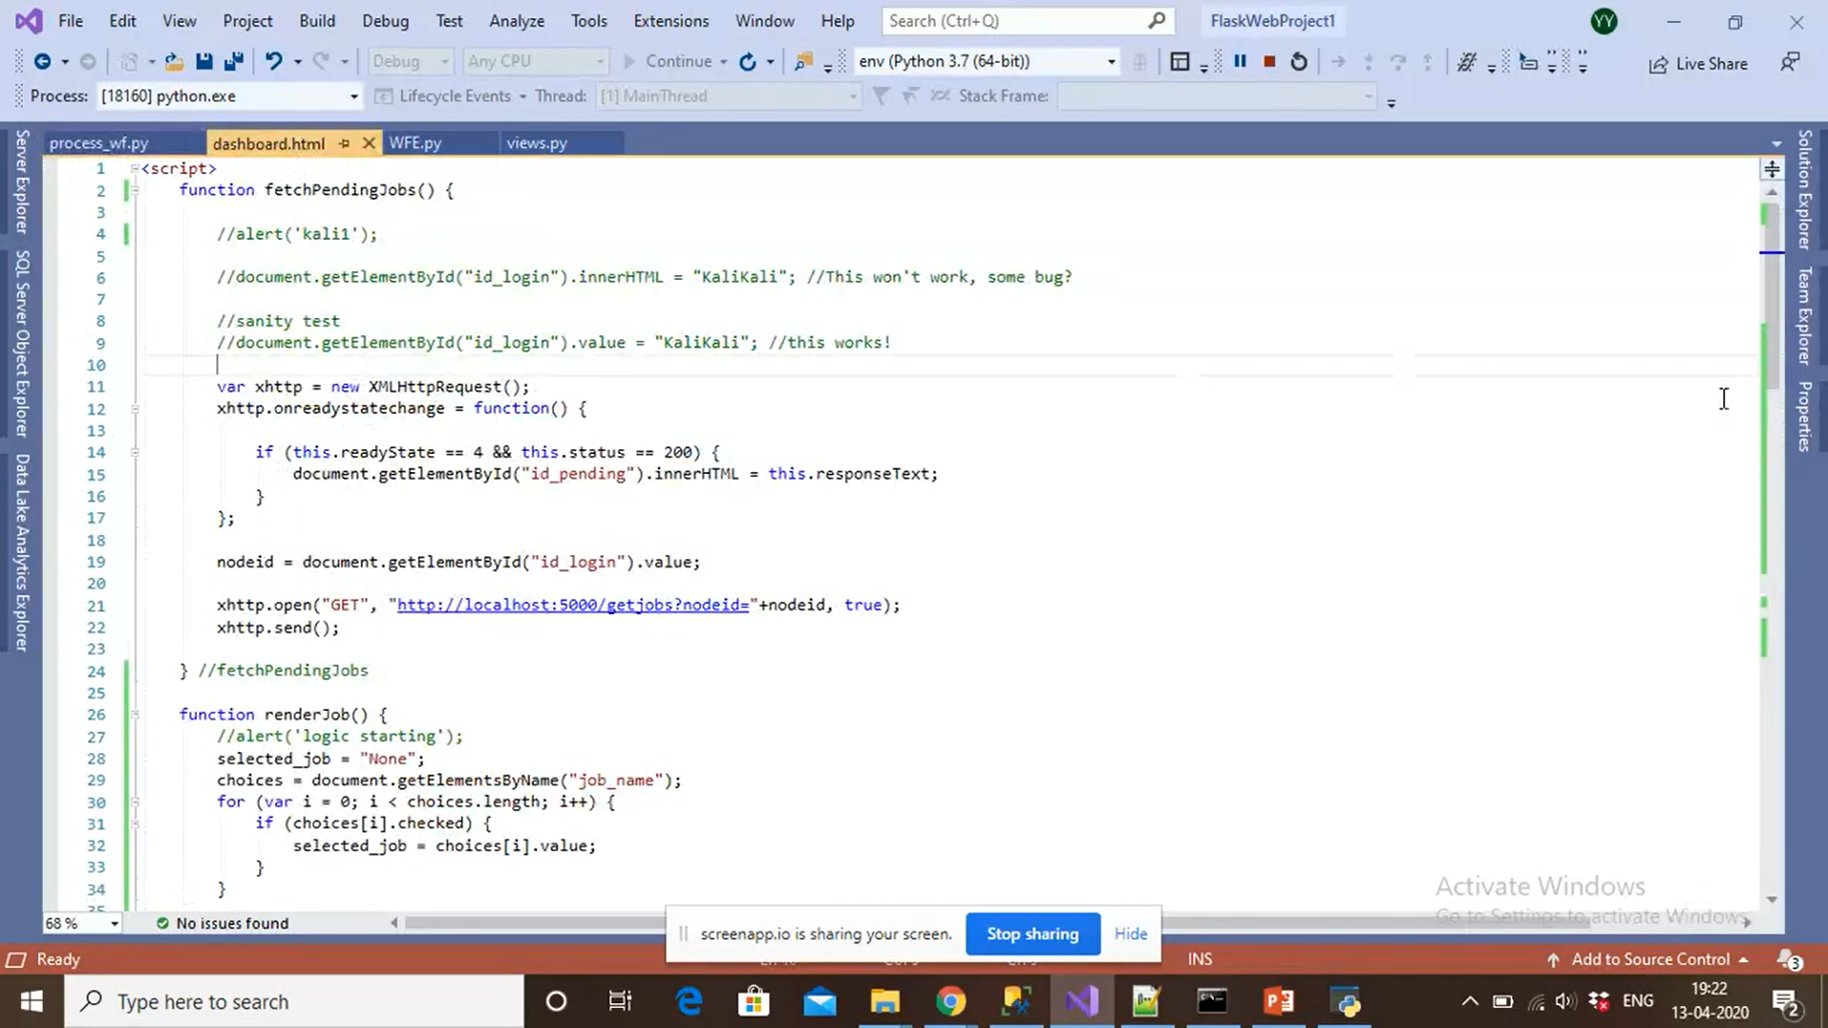
New Dashboard using Ajax, python for GUI rendering.

Slide 16
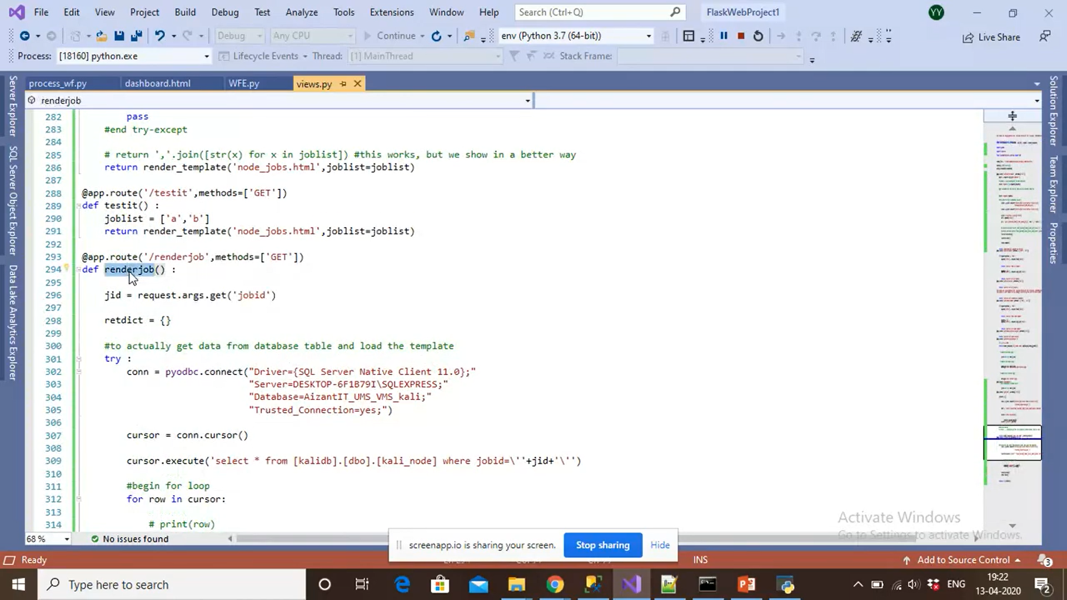
New views.py
Rendering a Job

Slide 17
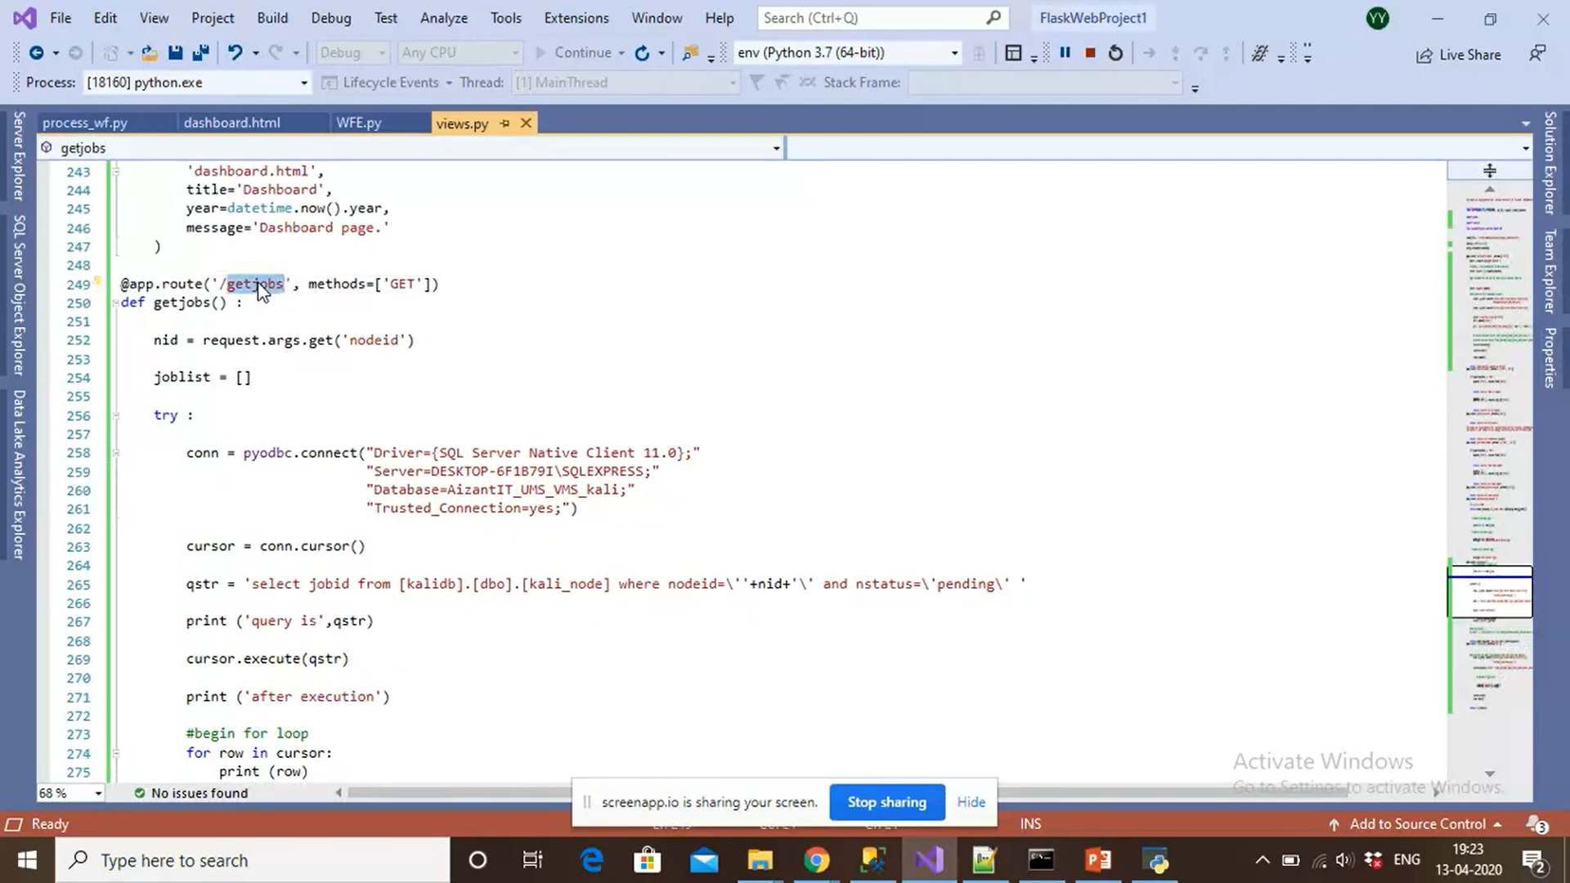
Pending jobs for a given node

Slide 18
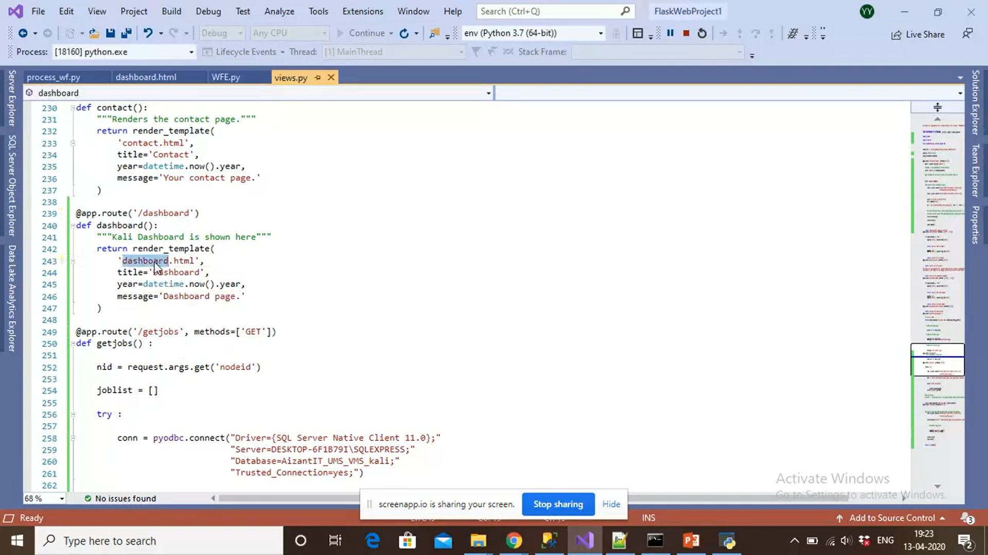
Dashboard renders dashboard.html

